Slide 1



On Named Entity Recognition: Deep Learning Approaches
Md. Shaharia Imran Ekran
Mourin Akter Mitu
Najnin jahan

Slide 2
Introduction
Named Entity Recognition (NER) is an important application in almost all-natural language processing (NLP) applications including data retrieval, data extraction, machine translation, and automated abbreviations. Named Entity Recognition (NER) helps people easily identify key elements of any text. Finding the essence of a text helps to sort out unsolicited data and identify important information, which is important if people need to deal with large datasets.
One of the major components of most information extraction (IE) and text mining systems is Named Entity Recognition (NER).

Slide 3
Motivation
For information extraction, this system is one of the key element.
Detect important information from large dataset.
Uses for classifying content for news providers, indexing document for any work, shop owners can verify their customers, a company can verify their employee etc. It will make the task of our daily office work much easier.

Slide 4
Objectives
To explore the basics of how NER works with high-level use cases and how they can be applied to a business or project.
To distinguish and classify each word in a report such as a few individual names, area names, organization names, different name, and "none of the over".
To identify relevant nouns in the documents or any content.

Slide 5
Related work
In a research, Asif Ekbal and Sivaji Bandyopadhyay has analyzed a Bengali news corpus which has approximately 34-million-word forms. A table-driven semi-automatic NE tag conversion routine is designed to convert sixteen-NE tagged corpus to twelve-NE tagged corpus. The corpus has been used to enhance the NER system in Bengali using pattern directed some machine learning approaches.
In another paper, bilingual NER tests on the tremendous Ontonotes 4.0 Chinese-English corpus appear that the proposed strategy can progress solid baselines for both Chinese and English. In specific, Chinese execution progressed by an outright F1 score of more than 5%.

Slide 6
Related work
In a research, Shammur Absar Chowdhury, Firoj Alam and Naira Khan use three type of features. Like word-level features, list lookup features, word-embedding features and they also use POS. They use CRFs model for designing their sequence classification model. They also use it to extract POS tag for their task.
A paper conversion routine has been developed in the paper of Asif Ekbal and Sivaji Bandyopadhyay to convert any sixteen-NE tagged corpus to a twelve-NE tagged corpus. The sixteen-NE tagged corpus of the 150K wordforms has been used to develop the NER system using various machine learning methods. Among the machine learning methods, the SVM method has worked through an overall F-score of 91.8%.

Slide 7
Contribution
In our study, we developed the system using both deep learning approach and machine learning approach.
We have worked on two languages like Bengali and English.
We developed LSTM Bi-LSTM-RNN model together for both English and Bangla dataset which gives the best accuracy 99.52% for English and 96.02% for Bengali.
LSTM and CRF model developed together for our project and this model has not been developed before for both Bengali and English Language.
SVM and GRU model also developed for NER system in Bengali and English.

Slide 8
Methodology
In this Project, we pre-processed the dataset and then we extracted the data and split the data from the dataset as train data (80%) and test data (20%).
IOB encoding has been used for English dataset and label encoder is used for Bangla dataset.
Overfitting is reduced by extracting features. Word embedding and count vectorizer were used here for enables the machine learning approaches to train faster.
Six types of classifiers like RNN, LSTM, Bi-directional LSTM, Support vector machine (SVM), Conditional Random Field (CRF) and Gated Recurrent Unit (GRU) have been applied to create the model. The results obtained from these classifications are measured and the model is evaluated. The performance of all the classification methods have been analyzed and compared, which classification can give the best results.

Slide 9
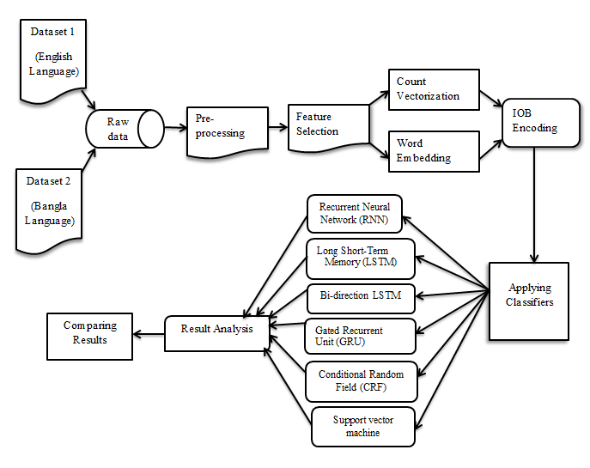
Framework of the proposed model

Slide 10

DATASET OVERVIEW AND PREPROCESSING :
Worked on English and Bangle dataset.
Used multi classification process.
English dataset has 17 tags and Bangle has 4 tags.
Reduce noisy data.
Convert into nominal data.
Word embedding.
Tokenization.

Slide 11
Tagset For English Dataset
NE tags | Meaning | Example
B-per I-per | Person Name Beginning or Internal of a multiword. | Mashrafe/ B-per Rahman/ I-per
B-org I-org | Organization Name Beginning or Internal of a multiword. | World/ B-org Health/ I-org Organization/ I-org
B-gpe I-gpe | Geopolitical Entity Beginning or Internal of a multiword. | United/ B-gpe Kingdom/ I-gpe
B-nat I-nat | Natural Phenomenon Beginning or Internal of a multiword. | Earthquake/ B-nat
B-eve I-eve | Event Name Beginning or Internal of a multiword. | Rabindra/ B-eve Jayanti/ I-eve
B-tim I-tim | Time Indicator Beginning or Internal of a multiword. | Morning/ B-tim 9/ I-tim o’clock/ I-tim
B-geo I-geo | Geographical Entity Beginning or Internal of a multiword. | United/ B-geo States/ I-geo Of/ I-geo America/ I-geo
B-art I-art | Artifact Beginning or Internal of a multiword. | Pottery/ B-art Vessels/ I-art
O | Outside of NEs | O

Slide 12
Tagset for bangla dataset
NE tags | Meaning | Example
PER | Person name | Sakib/ PER
ORG | Organization name | JAAGO Foundation/ ORG
LOC | Location name | Dhaka/ LOC
OBJ | objectives | Anything else which not exist in the entity list.

Slide 13
RESULTS Analysis FOR ENGLISH LANGUAGE
Models | F1 Score | Precision | Recall
LSTM, Bi-LSTM and RNN | 85.6% | 85% | 86%
GRU | 72% | 71% | 74%
LSTM and CRF | 80% | 81% | 80%
SVM | 88% | 87% | 91%

Slide 14
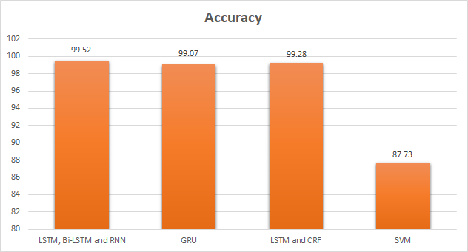
RESULTS Analysis FOR ENGLISH LANGUAGE

Slide 15
RESULTS Analysis FOR Bangle LANGUAGE
Models | F1 Score | Precision | Recall
LSTM, Bi-LSTM and RNN | 76.9% | 80% | 76%
GRU | 21.2% | 41% | 14%
LSTM and CRF | 8.8% | 10% | 7%

Slide 16
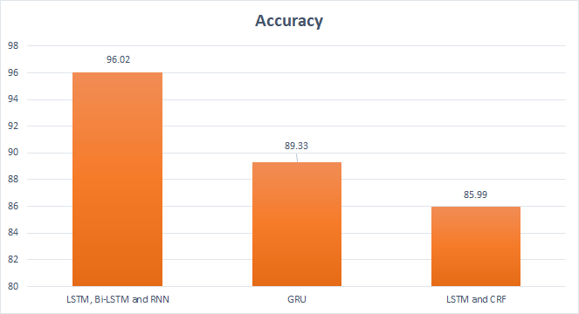
RESULTS Analysis FOR Bangle LANGUAGE

Slide 17
Conclusion
Named Entity Recognition has been developing persistently for over 15 years. The novel employments it to extricate distinctive types of data (name, date, time, location) from the content. In expansion, there are more than 20 languages and more than 200 types of entities. Most analysts are curious about specific data on topic types such as news articles, web page data, etc.
We developed the NER system with both machine learning and deep learning approaches. From these classifiers, we find out the best accuracy rate which is 99.52% for English and 96.02% for Bangla with the LSTM Bi-LSTM-RNN model.

Slide 18


